Slide 1
SUN, GROUND, & SKY for Microwave System Evaluation
Paul Wade W1GHZ
Don Twombly W1FKF

Slide 2
Thermal Noise
Everything generates noise
Proportional to Absolute Temperature
Sky ≥ 3.2K (Microwave Background Radiation
Ground 290K ±
Sun ~ 6000K
All available in your backyard

Slide 3
System Noise Figure
Measure difference Y in dB between cold sky and ground
$Y_{dB=10\log_{10}\left(\frac{T_{system}+T_{ground}}{T_{system}+T_{sky}}\right)}$
Solve for T_{system}
Use nfskydb.xls calculator spreadsheet by Ed Munn W6OYJ (SK)
http://www.ham-radio.com/sbms/sd/swindex.htm

Slide 4
System Noise Figure Example
Perfect Receiver – Tsystem = 0
$Y_{dB=10\log_{10}\left(\frac{T_{system}+T_{ground}}{T_{system}+T_{sky}}\right)}$
$\frac{T_{ground}}{T_{sky}}$=$\frac{290}{3.2}$=90
19 dB

Slide 5
System Noise Figure Example
Good Receiver – 1 dB NF Tsystem = 77K
$Y_{dB=10\log_{10}\left(\frac{T_{system}+T_{ground}}{T_{system}+T_{sky}}\right)}$
$\frac{T_{ground}}{T_{sky}}$=$\frac{77+290}{77+20}$=3.8
5.8 dB

Slide 6
System Noise Figure Example
OK Receiver – 3 dB NF Tsystem = 290K
$Y_{dB=10\log_{10}\left(\frac{T_{system}+T_{ground}}{T_{system}+T_{sky}}\right)}$
$\frac{T_{ground}}{T_{sky}}$=$\frac{290+290}{290+20}$=1.9
2.7 dB

Slide 7
System Performance by Sun Noise
Measure difference Y in dB between cold sky and sun
$Y_{dB=10\log_{10}\left(\frac{T_{system}+T_{sun}}{T_{system}+T_{sky}}\right)}$
Use EMEcalc by VK3UM (SK) for expected result (other programs also)
See how far off you are
Improve system

Slide 8
Effective T_{sun}
T_{sun} ~6000K if sun fills dish aperture
Sun diameter ~0.5 degrees
Small dish – beam larger than sun, rest of beam sees T_{sky}
$T_{effective}\sim 6000K∗{\left(\frac{SunRadius}{0.5∗Beamwidth}\right)}^{2}$ Approx!
For 3° Dish, T_{effective} ≈ 167K
With 1 dB NF, Y_{db} ≈ 4 dB
Active sun increases noise – record solar flux

Slide 9
Noise Measurement
Differences of a few dB – not with S-meter
Need wide bandwidth or averaging for stable readings
Sun noise meter
Software is better
TotalPower by I0NAA with RTL-SDR
WSJT
others

Slide 10
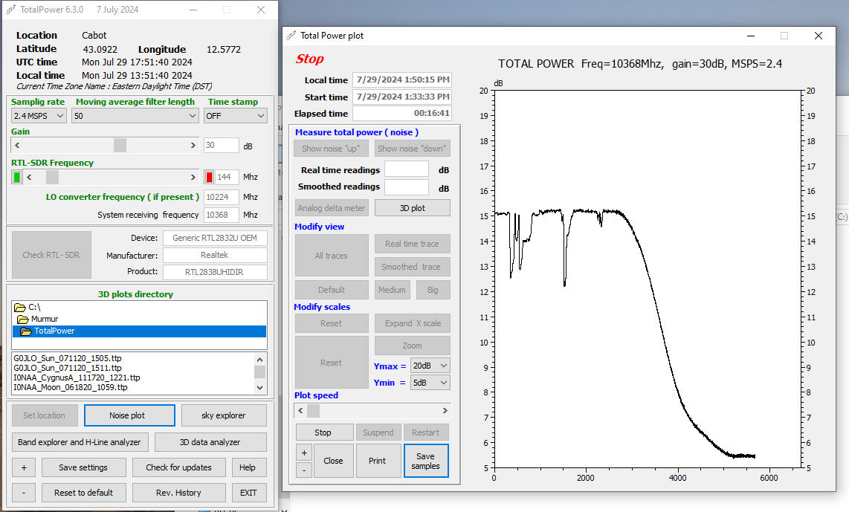
TotalPower by I0NAA with real RTL-SDR v3 or later ($30)

Slide 11
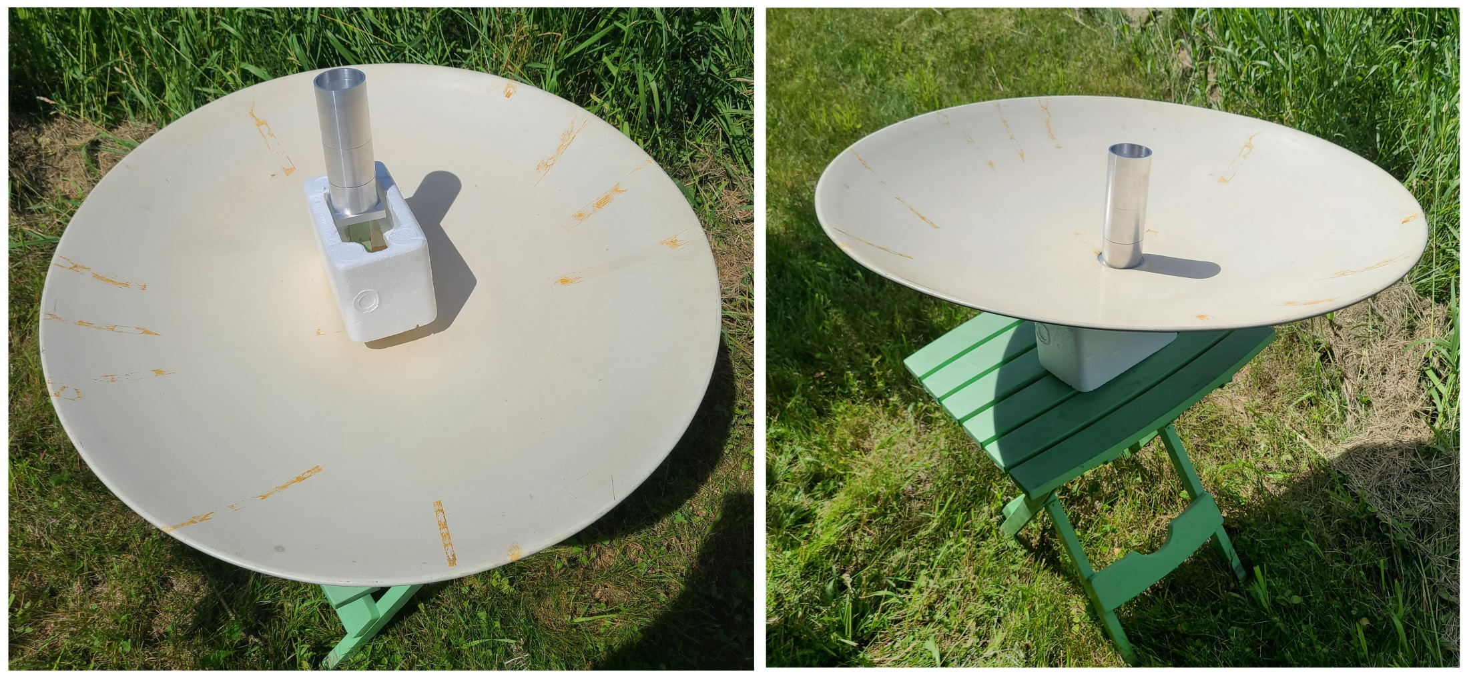
Noise Figure using Feedhorn inside dish to reduce ground noise from sidelobes

Slide 12
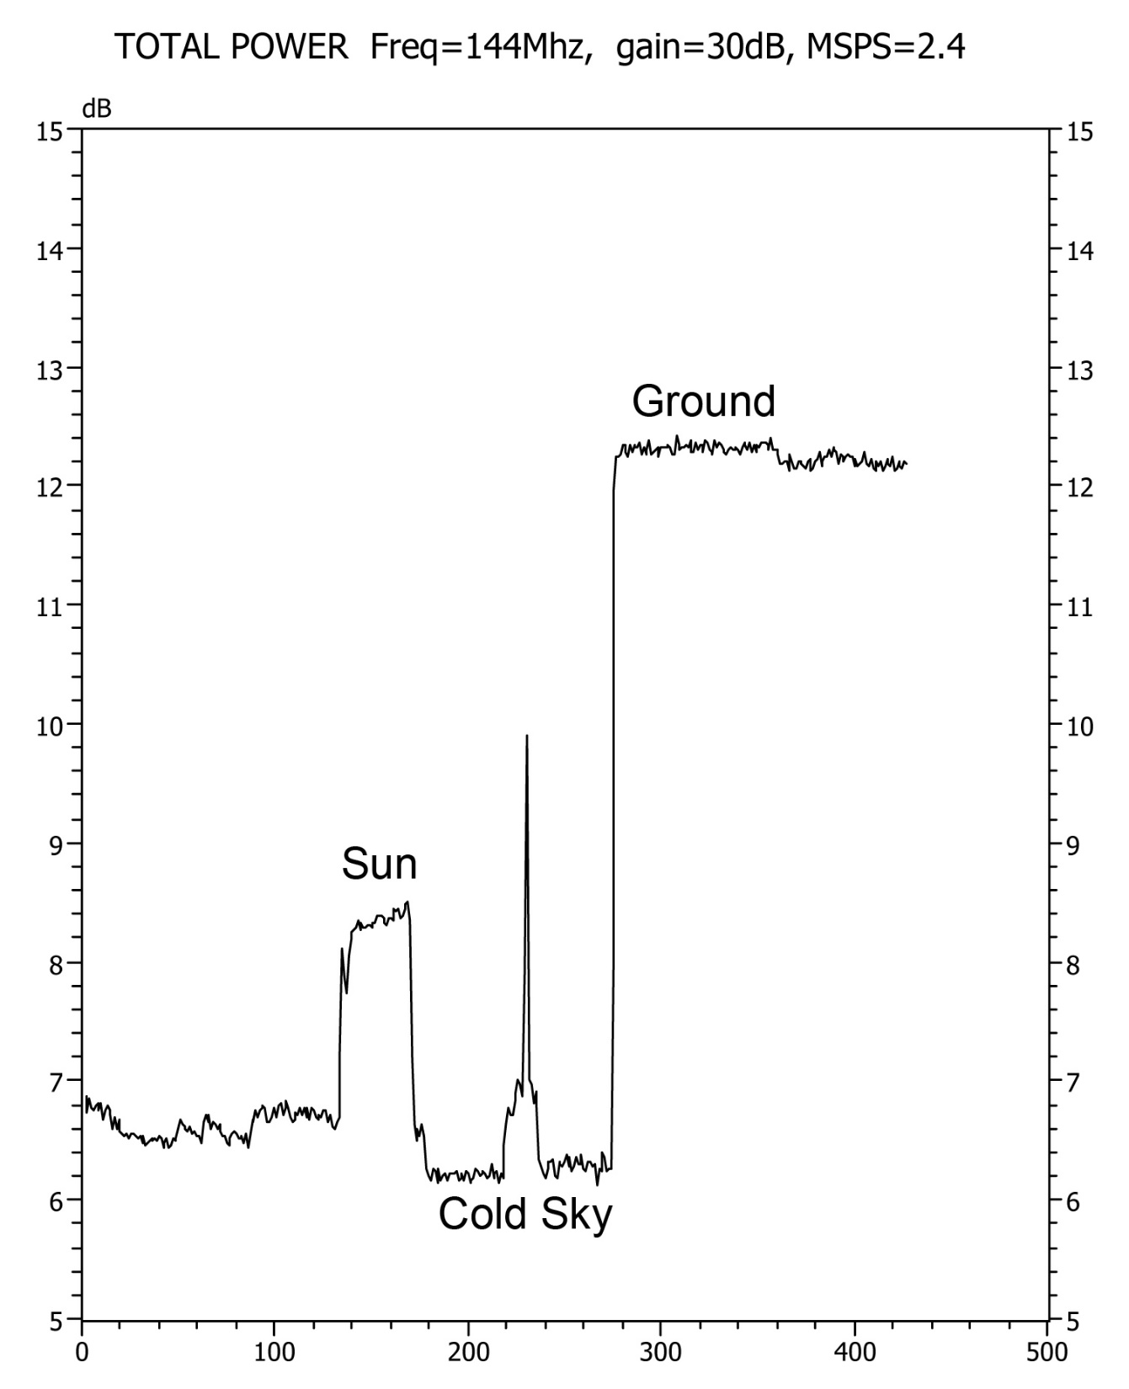
Noise Figure using Feedhorn NF ~ 0.8 dB

Slide 13
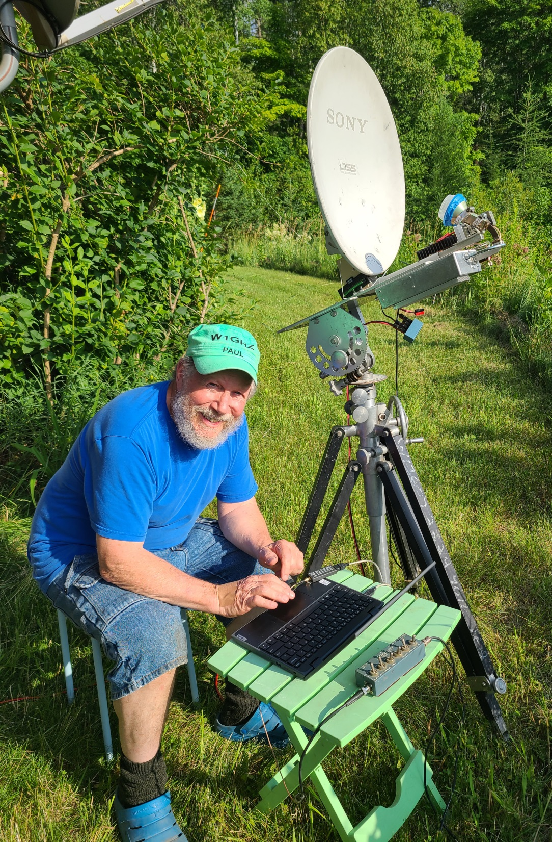
Small dish system performance

Slide 14
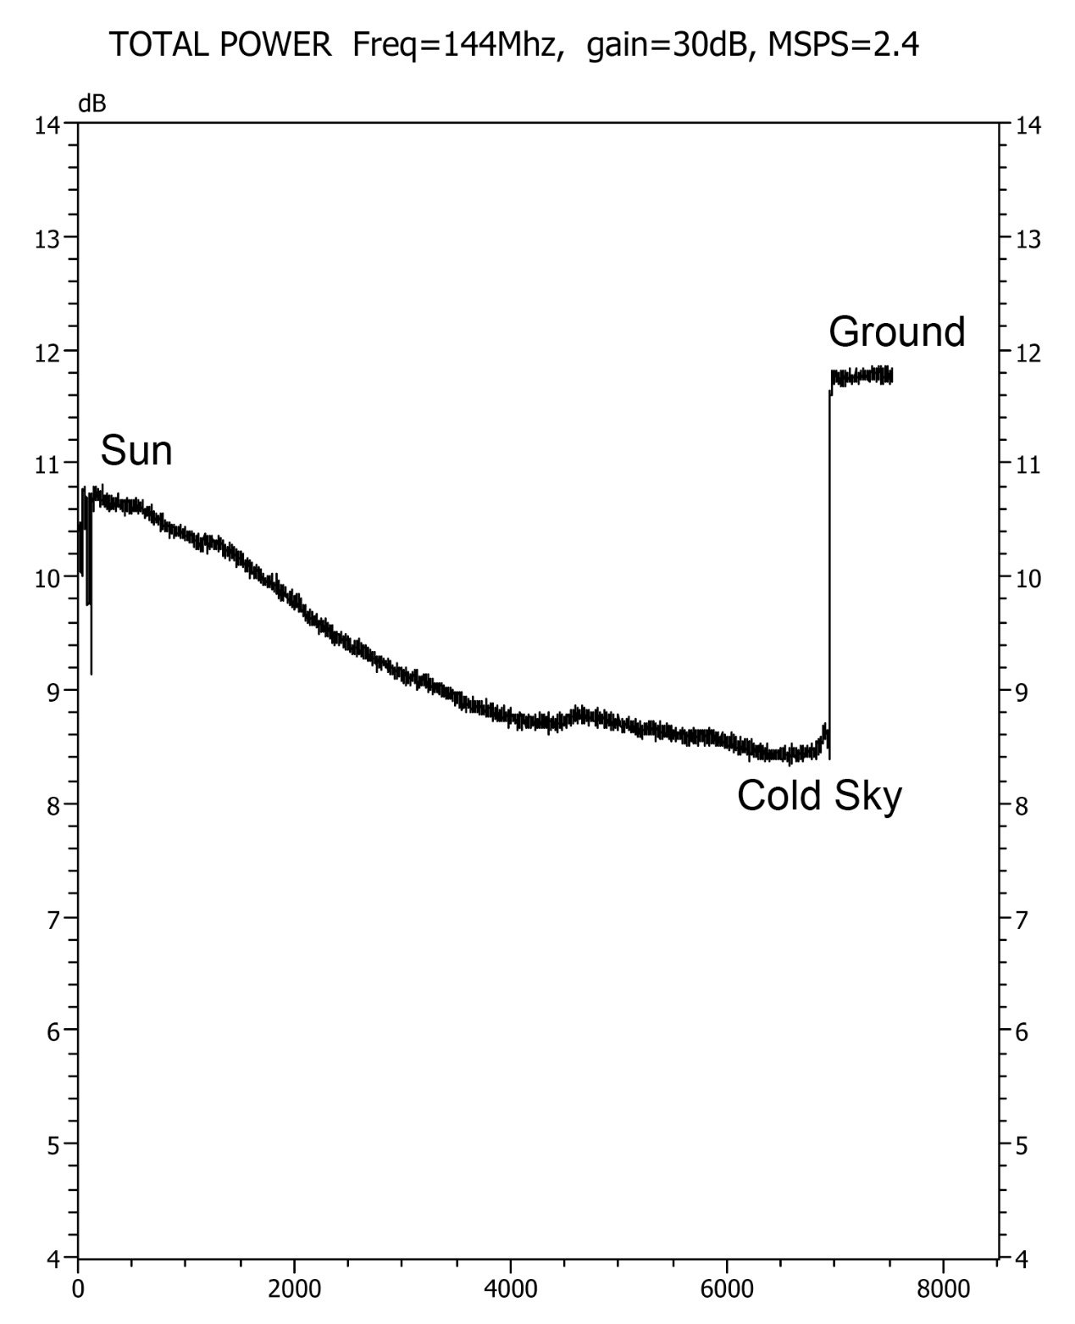
Small Dish Peak on sun, Earth rotates to cold sky, then point at ground

Slide 15
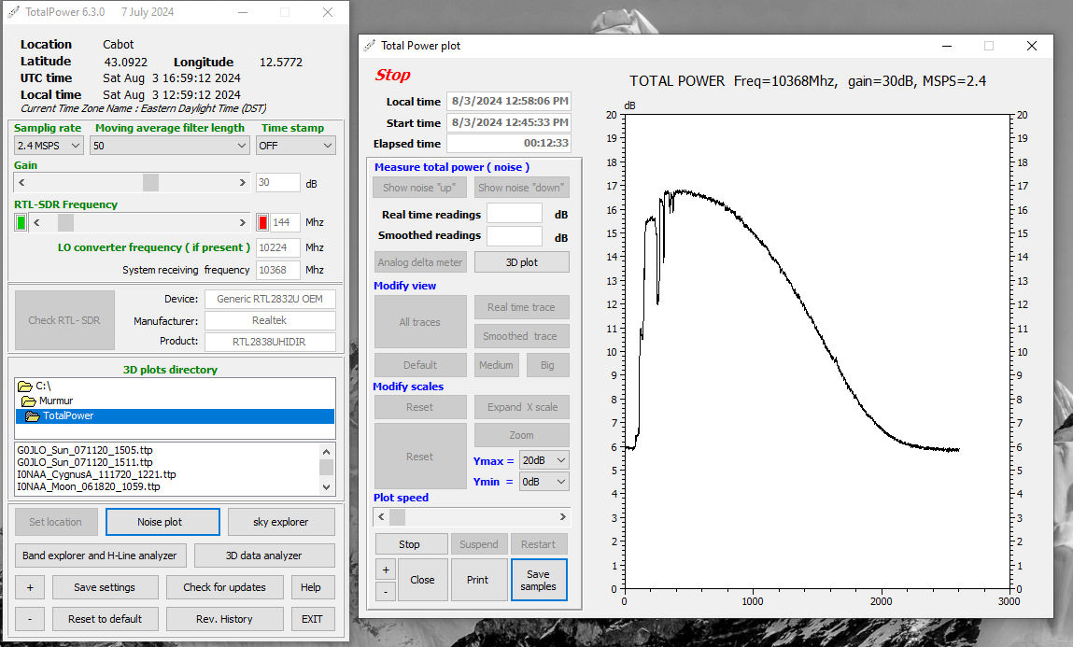
Drift plot – larger dish (1.2 meter)

Slide 16
Some Measurement Hints
Cold sky – near constellation Leo
General area - north, roughly 45° elevation
Ground
Grass at angle or trees at distance
Pointing directly may change VSWR slightly
Pavement reflects sun or sky
Step attenuator in line
Make sure above noise floor, below compression (indicated dB = real dB)

Slide 17
Sun Noise Hints
Sun high in sky
Peak on sun, mark shadow on dish for easier aiming
Offset dish – measure angle, subtract sun elevation to find tilt at horizon
Shiny dish will heat feed quickly
1 KW / square meter
Wear sunscreen

